Slide 1

Haukainga Home Winds
Presented by: Talgat Narbaev, Lukas Weitzer, Michael Amann

Slide 2
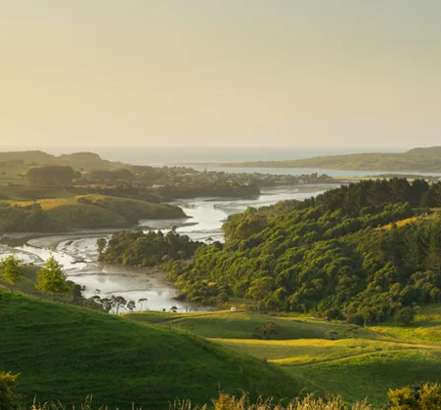
Overview of Business
Haukainga Home Winds is property booking web-based system for New Zealand market in Maori culture themed design to provide user-friendly and comfortable space for our local property owners across urban and rural part of country to advertise their properties on targeted client base.

Slide 3
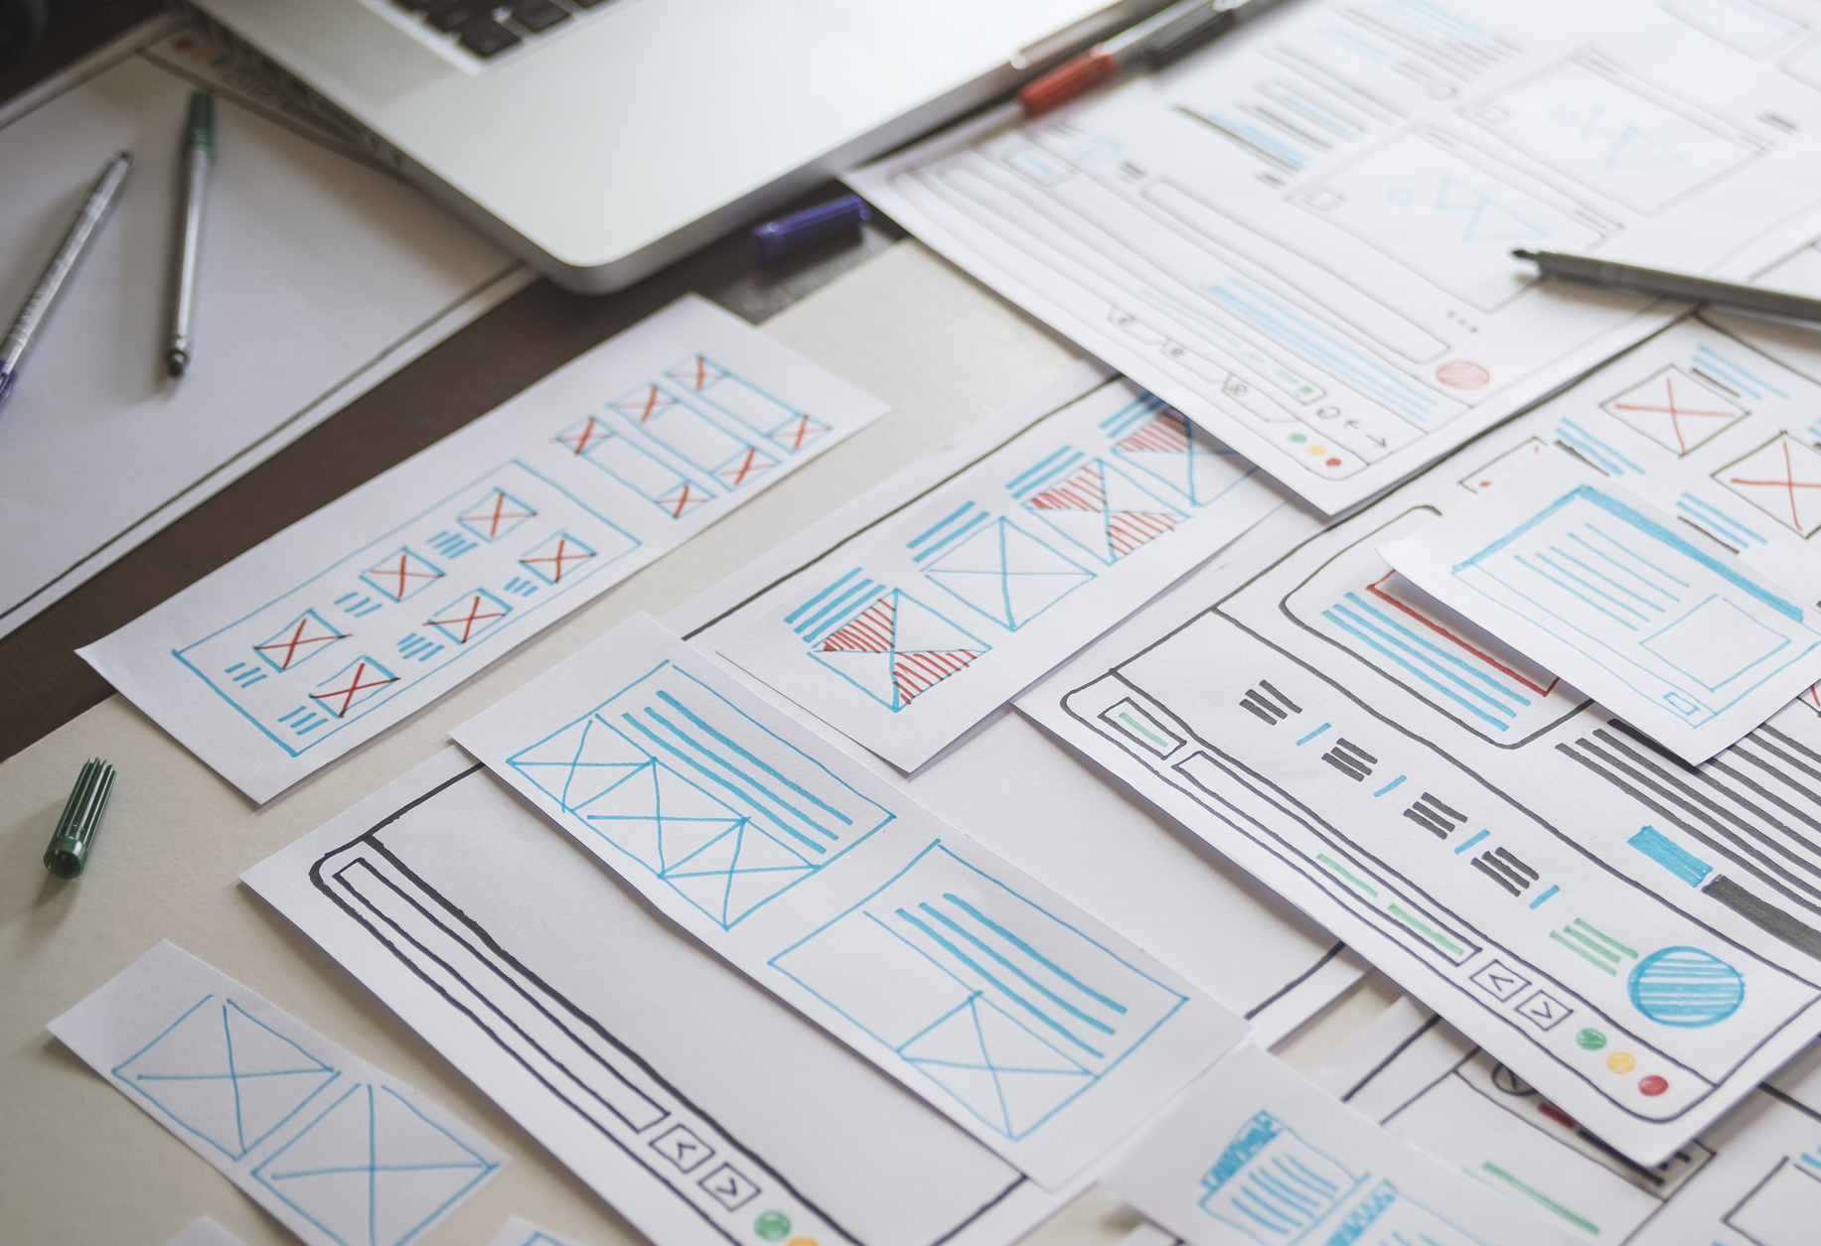
Our Proposed Product
Our product is fully functioning web-based system which meets all client’s requirements, expect some function such as photo ID identification where you need paid plugins.
However, property owners can publish their own properties, users can create an account, view the properties, make a booking and leave comment.
Whereas the admin has access over entire project and can regulate and manage the system.

Slide 4

Type - Web Application
To build the Web Application, we have chosen WordPress as our main platform to develop our product alongside with Hotel Booking Lite plugin by motopress group as main plugin for the project.
Addition to that, we have used additional plugins such as Elemontor(for editing), Members(for roles), Ultimate Member(account management), WP mail SMTP(for mail), WP Map Block(for map) and WP Forms Lite(for contact form).
Also, we have used GitHub for our project progress, contribution and up to date version of project.

Slide 5
Main features
Property Management
Create, modify and delete properties
Booking Management
Place, cancel and manage bookings
User Management
Create, modify and delete accounts
Manage rates, services and booking rules
Manage permissions of users

Slide 6
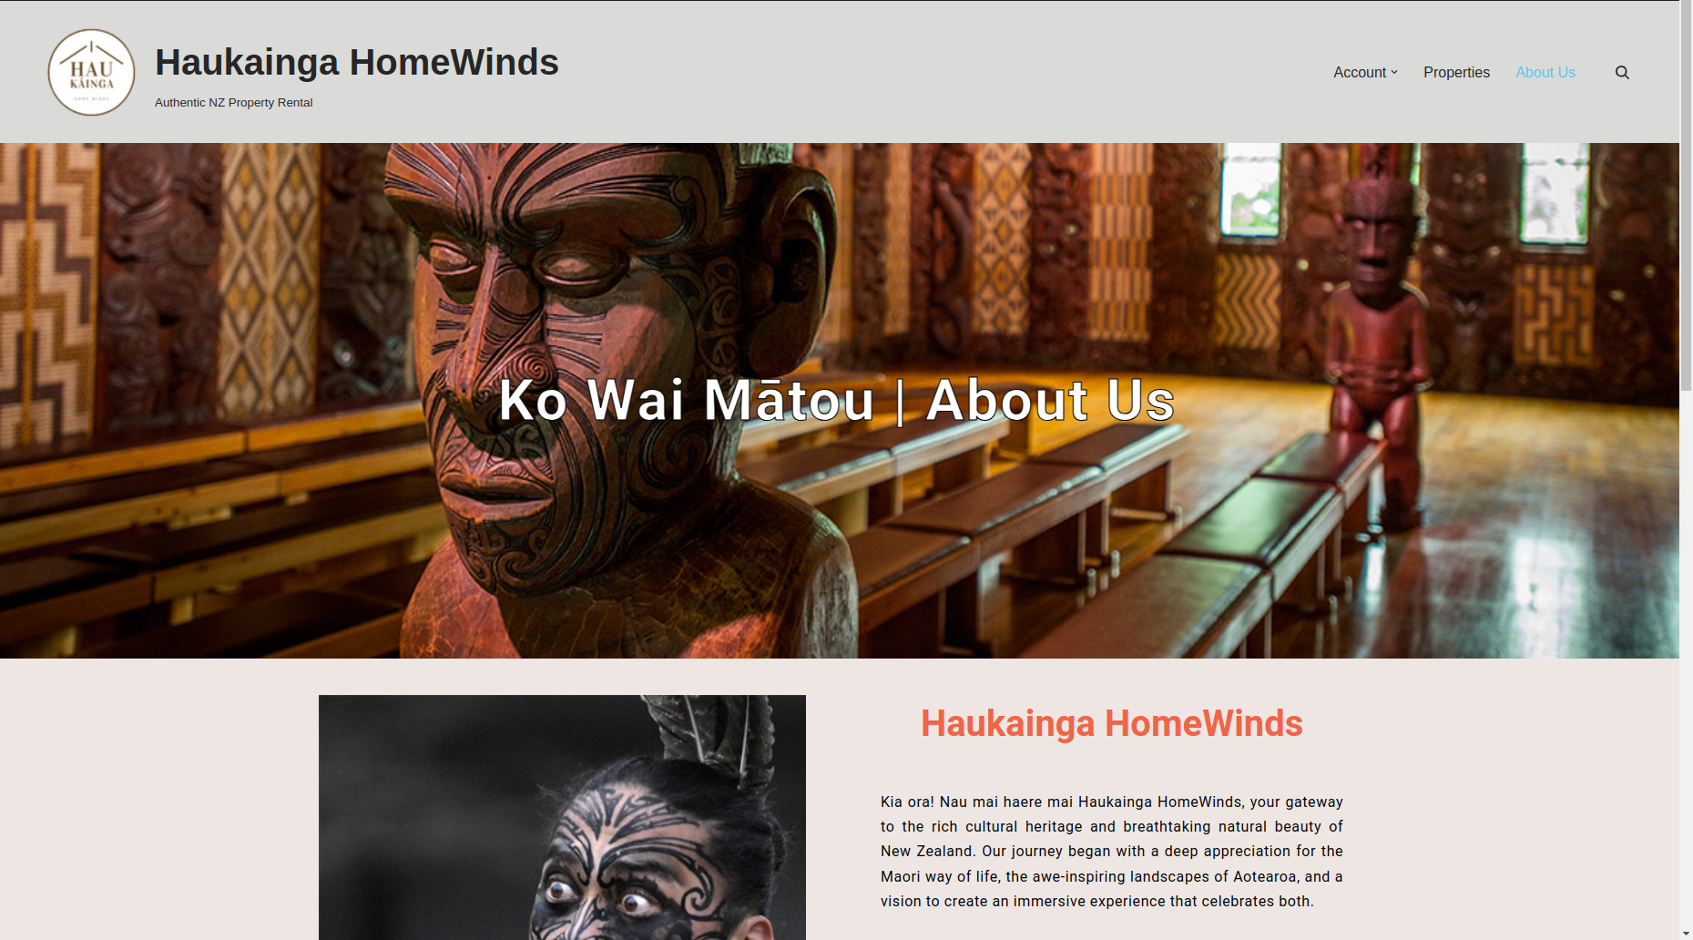
Design
Intuitive and User-friendly
Maori themed
Inviting UI
Simple but appealing

Slide 7
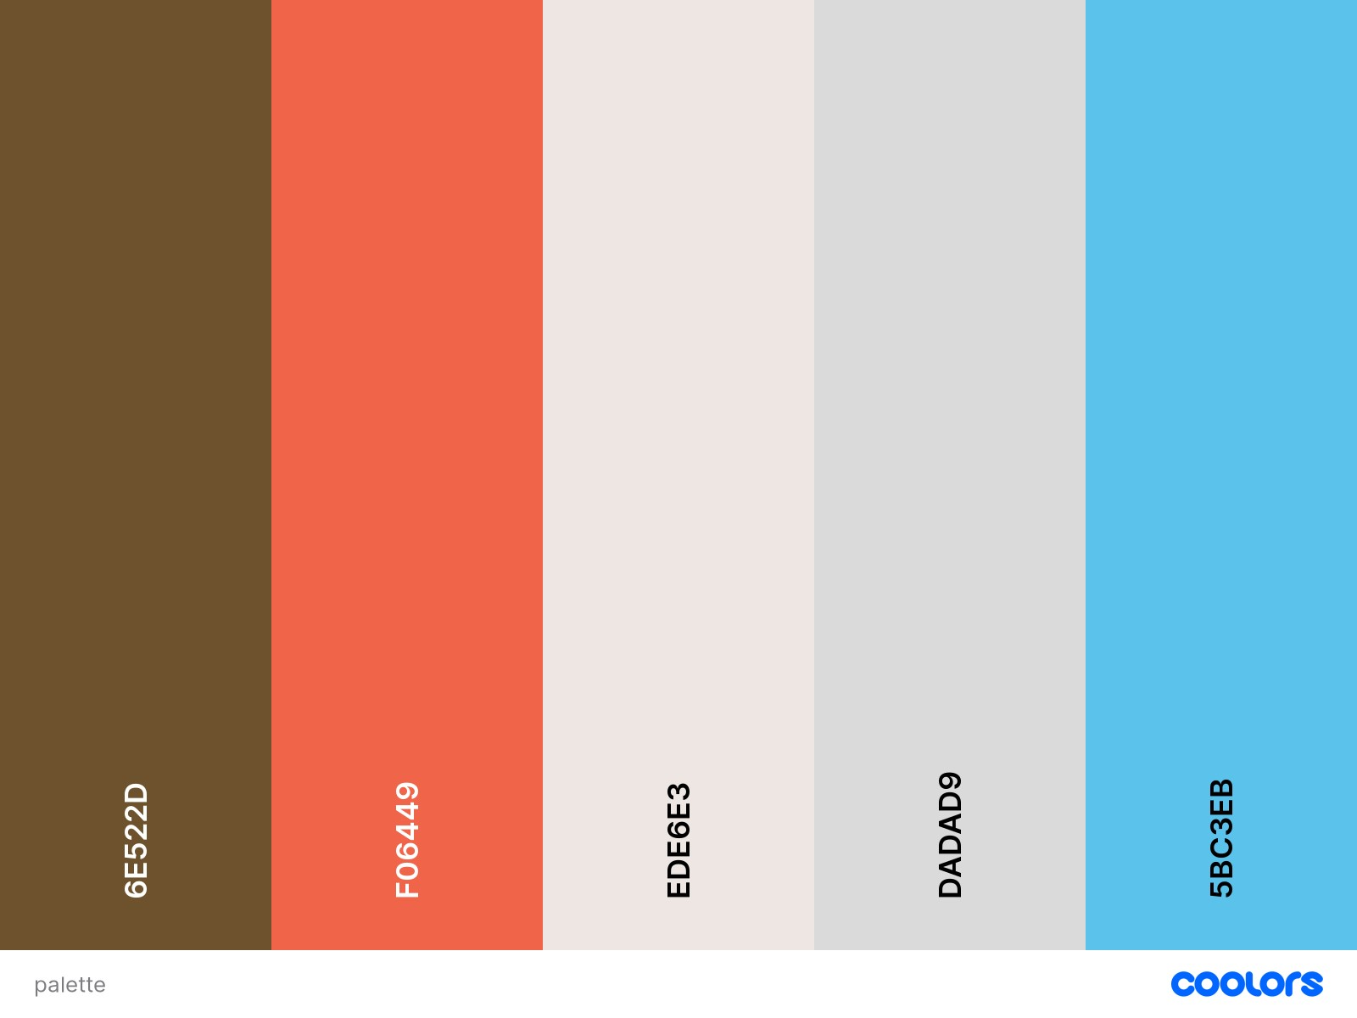
Design – Color Palette

Slide 8
Quick demo of the website
Here we will showcase the highlights of our work to date…

Slide 9

Constraints and boundaries
Free version of all used plugins
Photo ID part of Pro Version
Additional payment features need business related information
Required visual data from the client

Slide 10
Whats next?
Upgrade
Domain Name
Hosting Provider
Publish
Maintain

Slide 11

In Summary…
We believe we created a web application that matches the requirements and expectations of our client.
The website is easy to use, intuitive and reliable.
Using WordPress and business grade Plugins

Slide 12

Thank You

